Slide 1
BIBFRAME and Linked Data at the
University of Washington
Joseph Kiegel

Slide 2
Three Projects at UW
Conversion and review of MARC records in BIBFRAME
Mapping of RDA Core to BIBFRAME
Input form for native RDA cataloging

Slide 3
Versions of BIBFRAME
Used LC’s BIBFRAME (bibframe.org) in version 1.0
BIBFRAME 2.0 becomes available Spring 2016
Did not use Zepheira’s bibfra.me (BIBFRAME Lite)

Slide 4
Staff Training

Slide 5
Training as a First Step
Identified a core group of cataloging librarians with format and language expertise (including CJK) to be trained as BIBFRAME reviewers
Wrote in-house training for catalogers
Represented BIBFRAME in Turtle rather than in RDF/XML because Turtle is easier to read
Opened training sessions to all staff in technical services

Slide 6
Three Training Sessions
1) Introduction to review process and training in RDF
2) Training in the BIBFRAME model
3) Detailed reading of a converted MARC record
Later sessions were also held on RDF/XML and on Schema.org

Slide 7
Conversion and Review of
MARC Records in BIBFRAME

Slide 8
Goals of BIBFRAME Review
Familiarize ourselves with BIBFRAME
Evaluate the BIBFRAME model
Submit comments to Library of Congress

Slide 9
Core Group of Reviewers
Diana Brooking
Charlene Chou
Cate Gerhart
Theo Gerontakos
Joe Kiegel
Kris Lindlan
Helice Koffler
May Rathbone
Adam Schiff
Steve Shadle

Slide 10
Conversion Process
Selected and exported MARC records from our ILS
Converted records to MARCXML using MarcEdit
Converted records to BIBFRAME in RDF/XML using oXygen and the Library of Congress converter, accessed in GitHub
Converted RDF/XML to Turtle using a web service: rdf-translator.appspot.com

Slide 11
Review Sessions
Chose records for bib format, MARC fields, or language
Posted converted records prior to scheduled meetings
Invited interested staff to attend
Reviewed records in detail (1-3 records per session)

Slide 12
Sample of Title with Romanized and CJK Title

Slide 13
Results of the Review
Over 125 issues were submitted on the LC GitHub site
Types of problems reported
MARC fields or subfields not converted
BIBFRAME properties that showed problems
Non-roman script not handled well

Slide 14
CJK Problems with MARC Conversion
Missing CJK
Misplaced CJK
Duplicate CJK
Incorrectly formatted fields with CJK
Language tags

Slide 15
Missing CJK
CJK fields do not convert in several instances

Slide 16
Incorrectly Placed CJK
CJK subtitle is incorrectly placed with the title proper

Slide 17
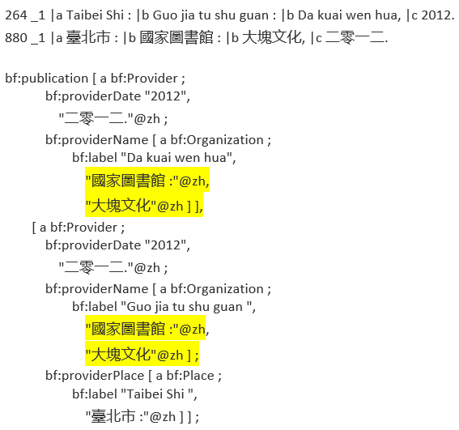
Duplicate CJK
Both names appear in CJK for each publisher

Slide 18
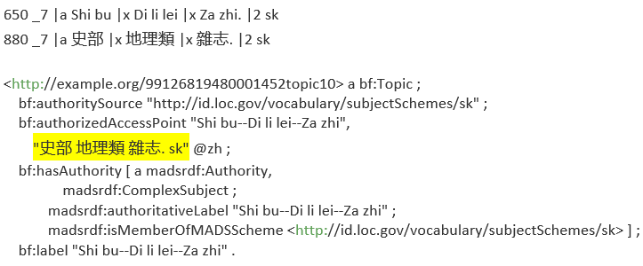
Incorrectly Formatted Fields with CJK
Subject heading omits dashes and includes subfield 2 in CJK

Slide 19
Language Tags
Language tags may be wrong in translations or bilingual editions

Slide 20
Mapping of RDA Core to BIBFRAME

Slide 21
Goals of the Mapping Project
Evaluate BIBFRAME as a carrier for RDA cataloging
Evaluate RDA/RDF as a serialization of RDA cataloging
Focus on RDA Core as a starting point
Available at:
http://faculty.washington.edu/kiegel/ld/rda-core-to-bibframe.pdf

Slide 22
Origin of the Document
The RDA BIBCO Standard Record metadata application profile by the Program for Cooperative Cataloging was taken as a basis for RDA Core
The column for MARC encoding was removed and two columns were added for RDA and BIBFRAME properties
Some editorial changes were made to reflect RDA in a non-MARC environment

Slide 23
RDA Problem with CJK and Non-Roman Scripts
Paired elements are not tied together

Slide 24
Problems in BIBFRAME
Some RDA properties do not map well to BIBFRAME
Series treatment in BIBFRAME needs an overhaul
Carrier details are not accounted for, e.g.
Base material
Book format
Video characteristics
File type
Regional encoding

Slide 25
Round Trip Problem in BIBFRAME
BIBFRAME does not support round trips from RDA
Some elements map to BIBFRAME, but cannot be mapped back to RDA, e.g.
Five RDA properties for extent map to bf:extent
Four RDA properties for scale map to bf:cartographicScale
Three RDA properties map to one for bf:note, bf:dimensions
Two RDA properties map to one for bf:edition, bf:language, bf:originDate, bf:musicMediumNote, bf:notation, bf:relatedWork

Slide 26
Input Form for Native RDA Cataloging

Slide 27
Goals of an Experimental RDA Input Form
Focus on RDA cataloging, in a similar way to RIMMF and the LC BIBFRAME Editor
Try alternative page layouts such as tabs
Use language tags throughout
Provide more holdings information than other forms

Slide 28
Tab Layout
Tabs for Expression, Manifestation and Item
Tabs for relationships for those classes

Slide 29
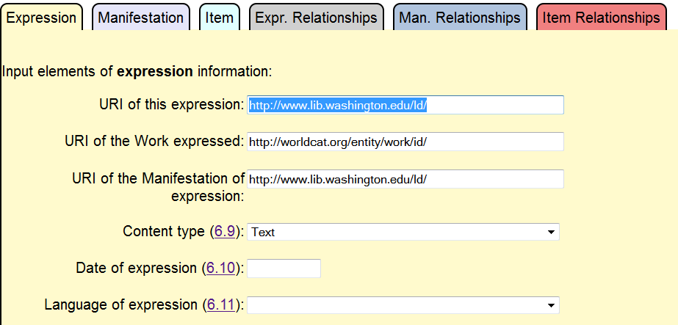
Expression

Slide 30
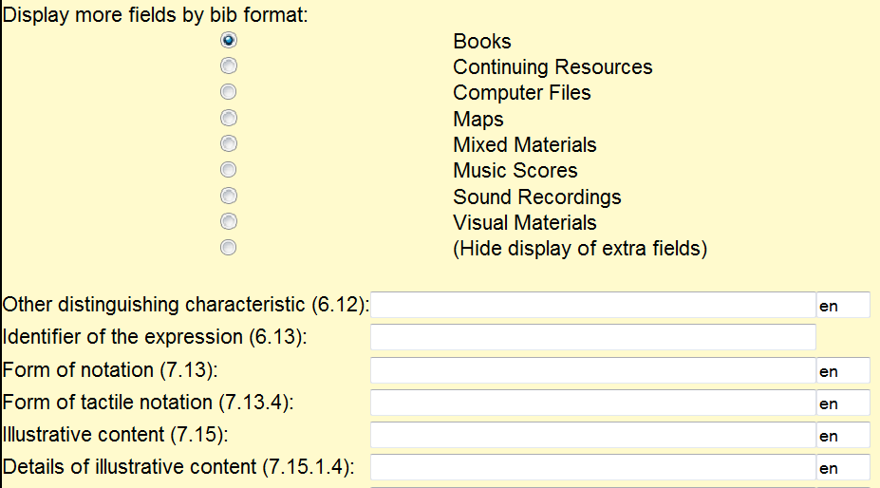
Additional Expression Elements

Slide 31
CJK Input

Slide 32
Output Formats
Upon saving, output is automatically generated in RDA/RDF and in BIBFRAME using a pipeline and transformations
Linked data is a both/and environment, where we are not limited to a single schema or encoding standard
We can catalog in RDA while creating and exchanging data in multiple formats

Slide 33
Sample of RDA/RDF Output

Slide 34
Sample of BIBFRAME Output

Slide 35
RIMMF (RDA in Many Metadata Formats)
Comprehensive but long pages for each WEMI type
Lacks language tags
Lacks holdings information
Supports CJK input

Slide 36
LC BIBFRAME Editor
Allows only PCC core elements
Lacks language tags
Supports CJK input

Slide 37
More Information
UW Linked Data page
http://www.lib.washington.edu/msd/pubcat/ld

